Slide 1
Design and Development of Electronic Terrain and Obstacle Data (Areas 1 & 4) College of Engineering University of Tehran

Slide 2
Outline
Geospatial Information System (GIS)
Scope of Project
Phases of Project
Development of Iran eTOD
Development
Scope of Project
Notes:
AIXM is a sata exchange specification in order to define features and messages used to exchange information about the aeronautical data contained in AICM.

Slide 3
Geospatial Information System (GIS)

Slide 4
Geospatial Information System (GIS)
A computer-based system for capturing, storing, updating, manipulating, analyzing and displaying geospatial referenced information
Most of Aeronautical information is geospatially referenced and ideal for incorporation in a GIS.
Notes:
AIXM is a sata exchange specification in order to define features and messages used to exchange information about the aeronautical data contained in AICM.

Slide 5
Geospatial Information System (GIS)
Notes:
AIXM is a sata exchange specification in order to define features and messages used to exchange information about the aeronautical data contained in AICM.

Slide 6
Scope of Project

Slide 7
Scope of Project
Design and Development of eTOD for Iran Areas 1 &4
Based On
ICAO Annex 15, Doc 9881 and related standards
Iran Airport Company
Deputy For Aeronautical Operations
Aeronautical Information Management
College of Engineering
University of Tehran
Notes:
AIXM is a sata exchange specification in order to define features and messages used to exchange information about the aeronautical data contained in AICM.

Slide 8
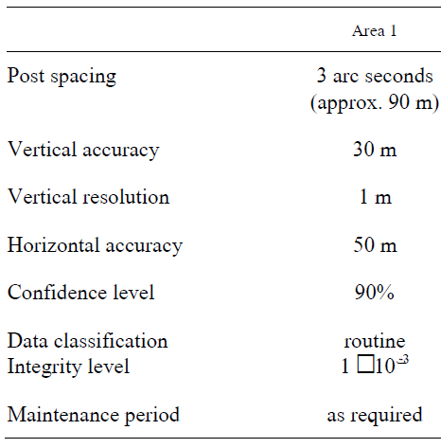
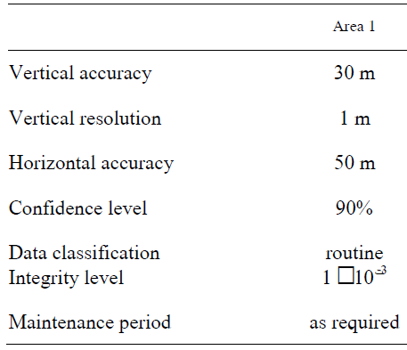
Scope of Project: Area 1
Area 1 Obstacles Shall be Higher Than 100 Meters
Area1: Entire Iran Territory
Area1 Terrain Numerical Requirements
Area1 Obstacles Numerical Requirements
Notes:
AIXM is a sata exchange specification in order to define features and messages used to exchange information about the aeronautical data contained in AICM.

Slide 9
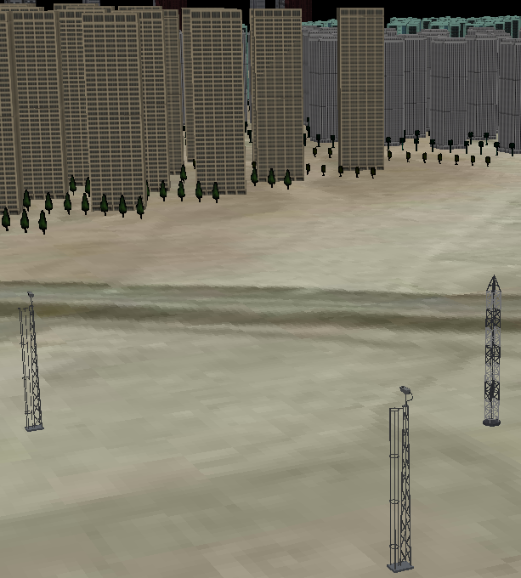
Scope of Project: Area1
Area 1 Obstacles Shall be
Higher Than
100 Meters
Area 1 Terrain
Area 1 Terrain
Notes:
AIXM is a sata exchange specification in order to define features and messages used to exchange information about the aeronautical data contained in AICM.

Slide 10
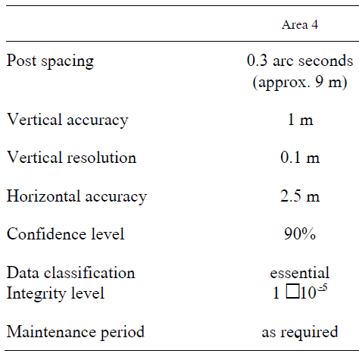
Scope of Project: Area4
Area4: Imam Khomeini Airport
Area4 Terrain Numerical Requirements
Notes:
AIXM is a sata exchange specification in order to define features and messages used to exchange information about the aeronautical data contained in AICM.

Slide 11
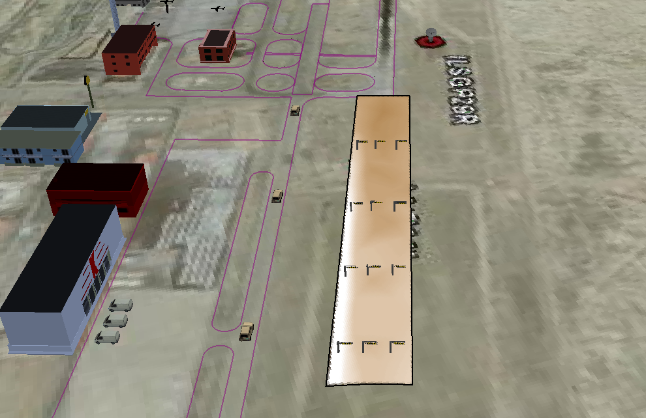
Iran ImamKhomeini Airport Area4
120 * 900 m

Slide 12
Phases of Project

Slide 13
Phases of Project
Phases of Project
Phase 1
Feasibility Study
Phase 2
Data Collection
Phase 3
Data Product Specification Structure
Phase 4
Development of Iran eTOD (Areas 1 & 4)
Notes:
AIXM is a sata exchange specification in order to define features and messages used to exchange information about the aeronautical data contained in AICM.

Slide 14
Phases of Project
Phases 1: Feasibility Study
Question forms
AIM office tasks and structure
International experiences
Eurocontrol related Documents
eTOD definitions
eTOD requirements
eTOD quality requirements
Based on Annex 15 & Doc. 9881
Notes:
AIXM is a sata exchange specification in order to define features and messages used to exchange information about the aeronautical data contained in AICM.

Slide 15
Phases of Project
Phases 2: Data Collection
Collection of Iran Terrain Data Based on Shuttle Radar Topography Mission (NASA)
Collection of Imamkhomeini topography maps
Related obstacles data within Iran AIP
Meeting and communicating with twenty related Organizations
Analysis of collected data based on ICAO Quality requirements
Notes:
AIXM is a sata exchange specification in order to define features and messages used to exchange information about the aeronautical data contained in AICM.

Slide 16
Phases of Project
Phases 3: Data Product Specifications structure
10.4.2. A comprehensive statement of available electronic terrain and obstacle data sets shall be provided in the form of Data Product Specifications (DPS)
ISO 19131 (Data Product Specifications)
ISO 19115 (Metadata)
ISO 19109 and ISO 19110 (Application Schema & Feature Cataloguing)
ISO 19113 and ISO 19114 (Quality principles and evaluation procedures)
Iran areas 1 and 4 DPS structure
Notes:
AIXM is a sata exchange specification in order to define features and messages used to exchange information about the aeronautical data contained in AICM.

Slide 17
Phase 4:
Design and Development
of Iran eTOD (Areas 1 & 4)

Slide 18
Iran eTOD (Areas 1 & 4)
Database Definition based on Annex 15
One or more files of data so structured that appropriate applications may draw from the files and update them.
Note.— This primarily refers to data stored electronically and accessed by computer rather than in files of physical Records.

Slide 19
Iran eTOD (Area1 & 4)
Development of Iran eTOD (Area1 & 4)
10.4.1 To allow and support the interchange and use of sets of electronic terrain and obstacle data among different data providers and data users, the ISO 19100 series of standards for geographic information shall be used as a general data modeling framework.
Design of Application Schema and Data Model Integration Diagram
Development of Iran eTOD
based on designed data Models
Based on ISO 19100 Series Standards

Slide 20
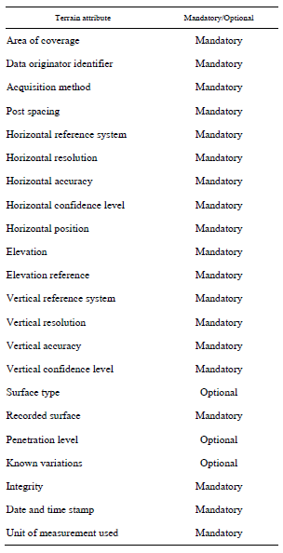
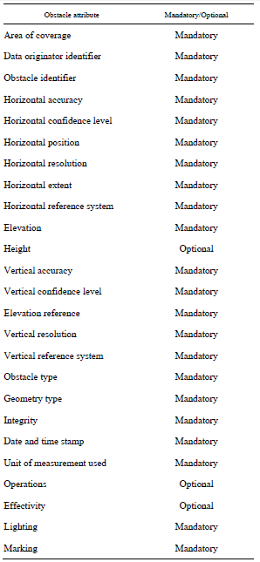
ICAO Attributes (Areas 1 & 4)
Annex 15
Doc. 9881
Eurocontrol
ISO 19100

Slide 21
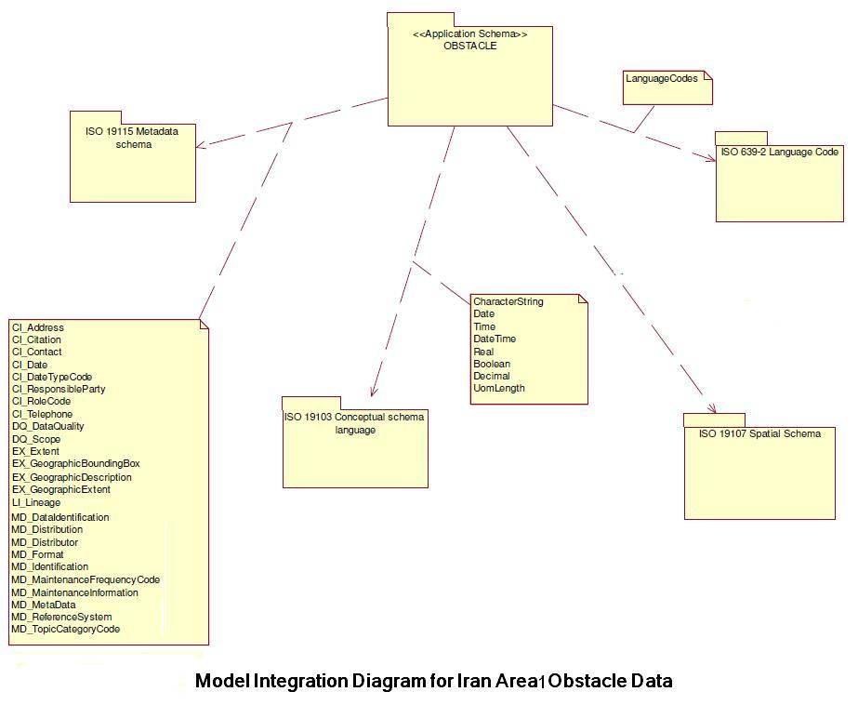
Design of Application Schema and Data Model Integration Diagram
Based on ISO 19100 Series Standards

Slide 22
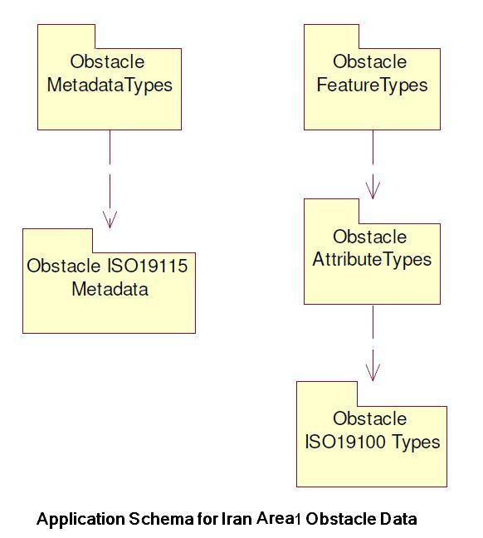
Design of Application Schema and Data Model Integration Diagram
Based on ISO 19100 Series Standards

Slide 23
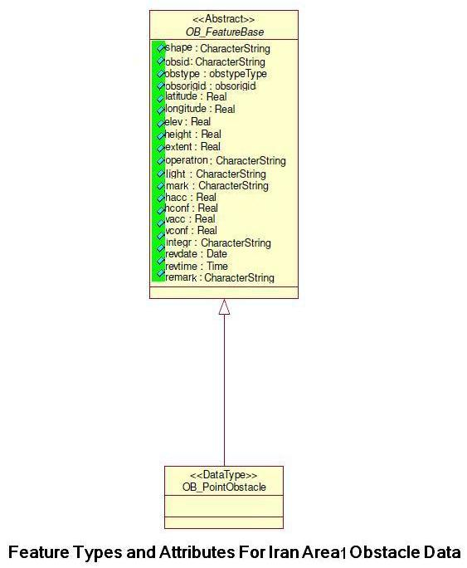
Design of Application Schema and Data Model Integration Diagram
Based on ISO 19100 Series Standards

Slide 24
Iran eTOD (Areas 1 & 4)
Feature Catalogue of Obstacle Datasets
ISO 19100 Series Standard

Slide 25
Iran eTOD (Areas 1 & 4)
DPS of Iran eTOD have been written in XML Codes Based on ISO 19100 Series Satandards.

Slide 26
Iran eTOD (areas 1 & 4) Storage structure
Iran eTOD Formats
Iran Area1 Obstacles Dataset: Shp.
Iran Area1 Terrain Dataset: Geotiff
Iran Area4 Terrain Dataset: Geotiff
Data Product Specification of above Datasets: XML.

Slide 27
Iran eTOD (areas 1 & 4) System
For displaying, storing, analyzing and updating the Iran eTOD Areas 1 & 4, a Specific Toolbar have been programmed based on a GIS.
Advantages
User friendly
Security
Based on ICAO standards
Visualization
Analysis and query
Traceability

Slide 29
END

